Slide 1
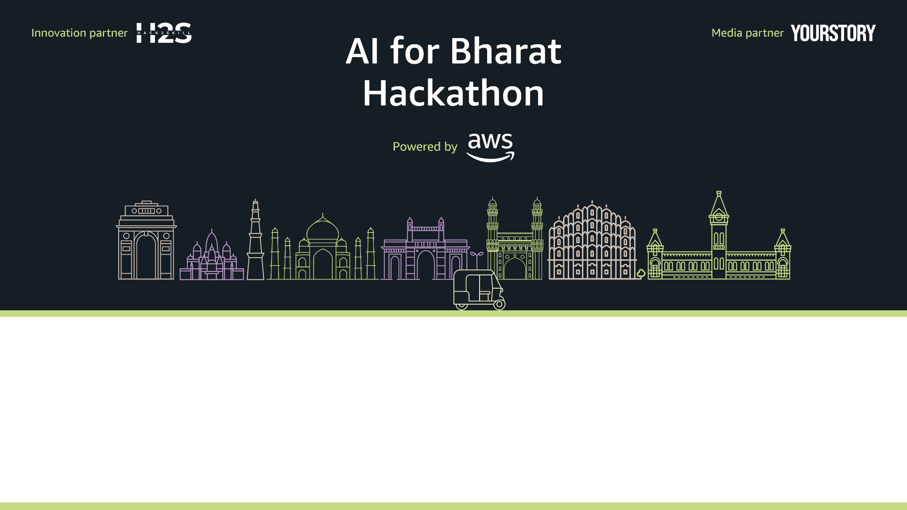
Team Name : KrishiSaathi
Team Leader Name : N. Shashidhar Reddy
Problem Statement : [Professional Track] AI for Rural Innovation & Sustainable Systems

Slide 2
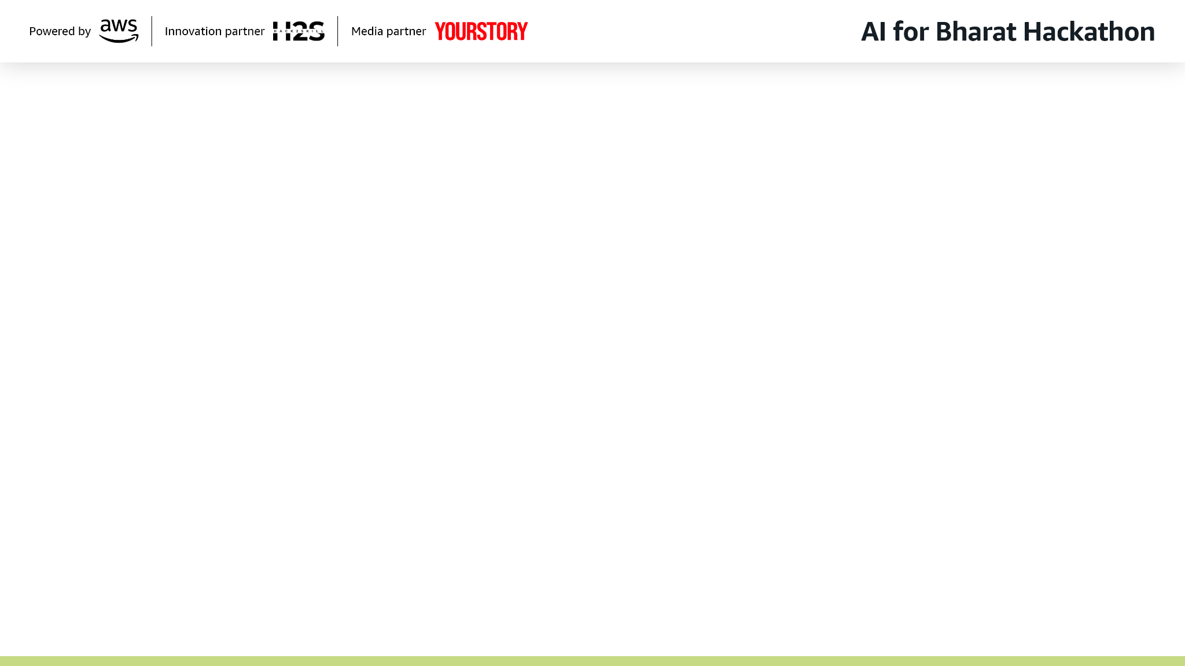
Brief about the Idea:
KrishiSaathi: AI-Powered Multi-Agent Agricultural Intelligence System
The Vision: A revolutionary system providing comprehensive assistance via 5 specialized AI agents working through Amazon Bedrock.
Core Pillars:
RAG-powered: Knowledge base of 50,000+ agricultural documents.
Voice-First: Supports 12 Indian languages for semi-literate accessibility.
Omnichannel: Available via Progressive Web App (PWA), WhatsApp, and SMS.
Connectivity: Offline-capable features for low-bandwidth rural areas.

Slide 3
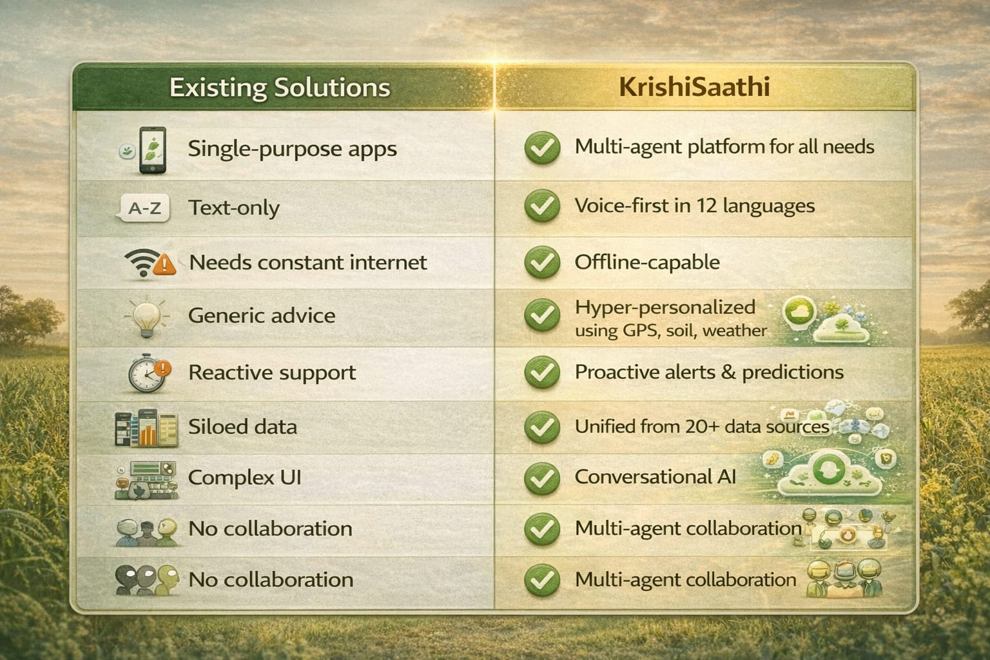
How is it Different from Existing Ideas?

Slide 4
How will it solve the problem?
Expert Access: "Crop Doctor" provides instant disease diagnosis via image analysis (95%+ accuracy) using Amazon Rekognition.
Market Transparency: "Market Agent" tracks 2000+ mandis with 7-day price predictions.
Language Barrier: Voice interface in 12 languages (Hindi, Tamil, Telugu, etc.) using Amazon Transcribe and Polly.
Climate Risks: "Weather Prophet" offers village-level alerts and crop-specific advice.

Slide 5
Unique Selling Points
Multi-Agent Collaboration: 5 AI agents consult each other for best decisions. (e.g., Weather Agent warns Crop Doctor not to recommend spraying before rain).
Hyper-Personalized: Uses GPS and Soil Health Card data for field-specific advice rather than generic tips.
WhatsApp-Native: No complex app installs; works where farmers already are.
Offline-First RAG: Compressed knowledge base works without internet.
Community Learning Network: Learns from farmer queries to give regional alerts.

Slide 6
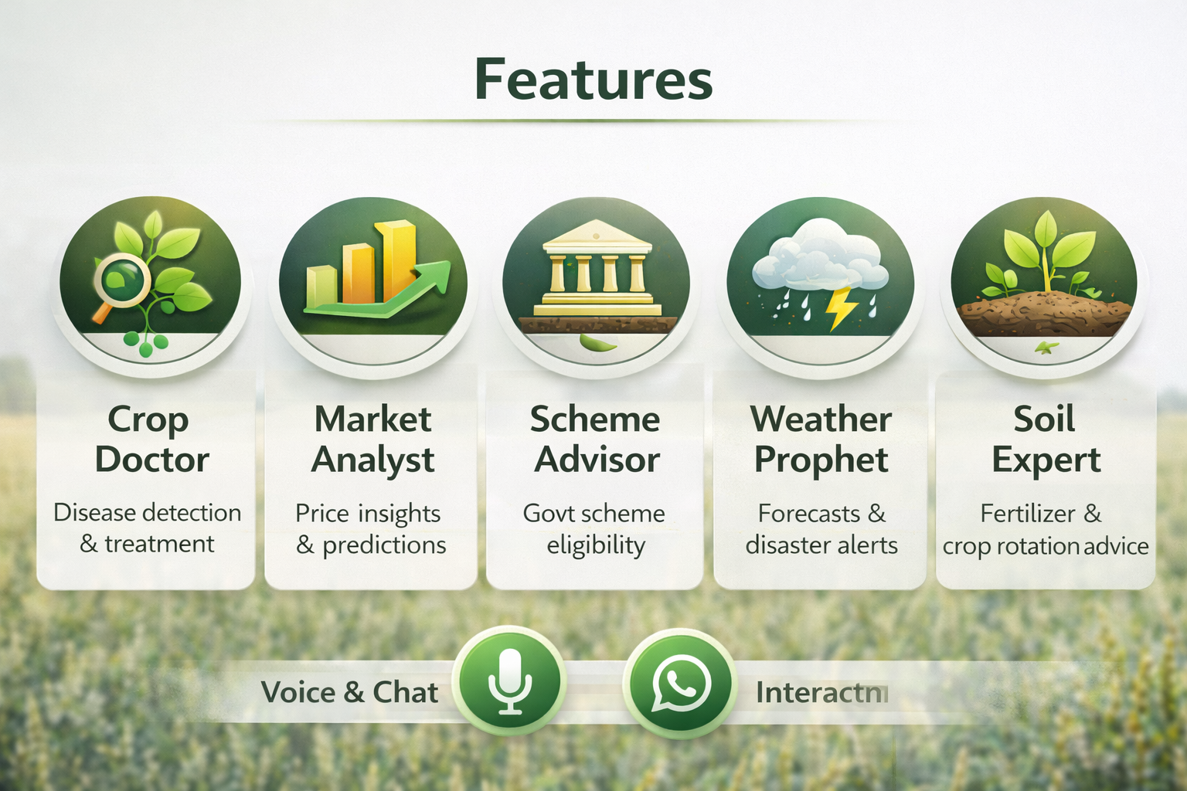
List of features offered by the solution

Slide 7
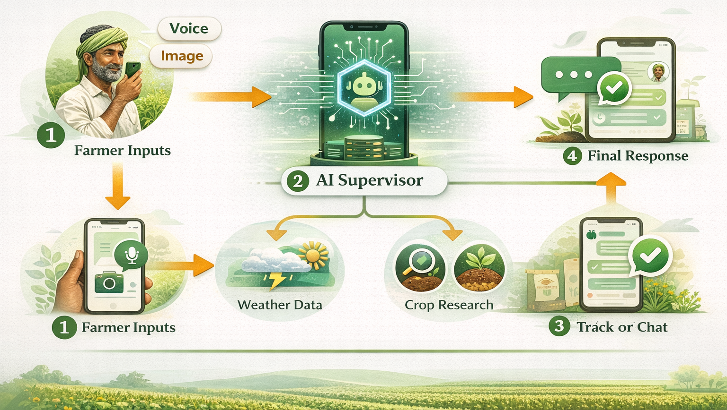
Process Flow Diagram

Slide 8
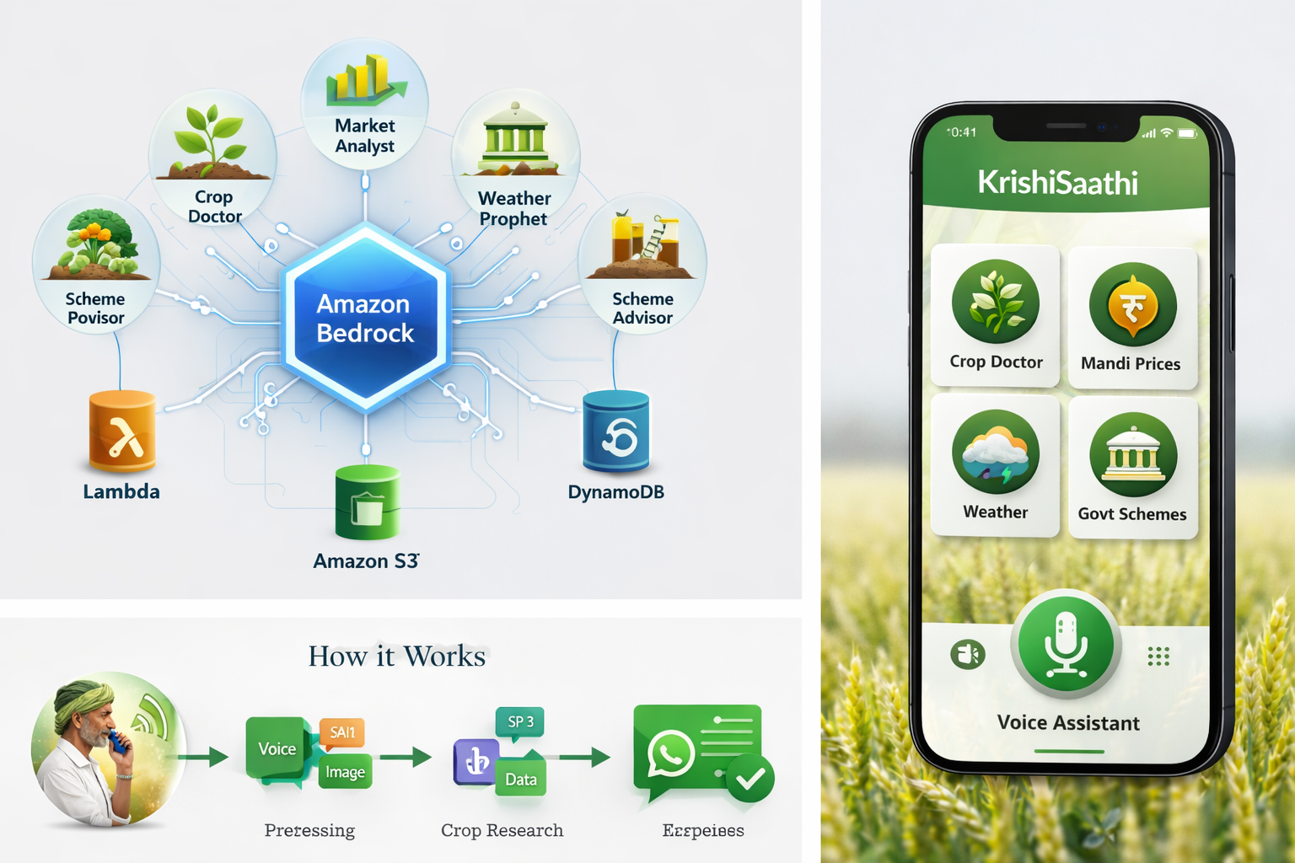
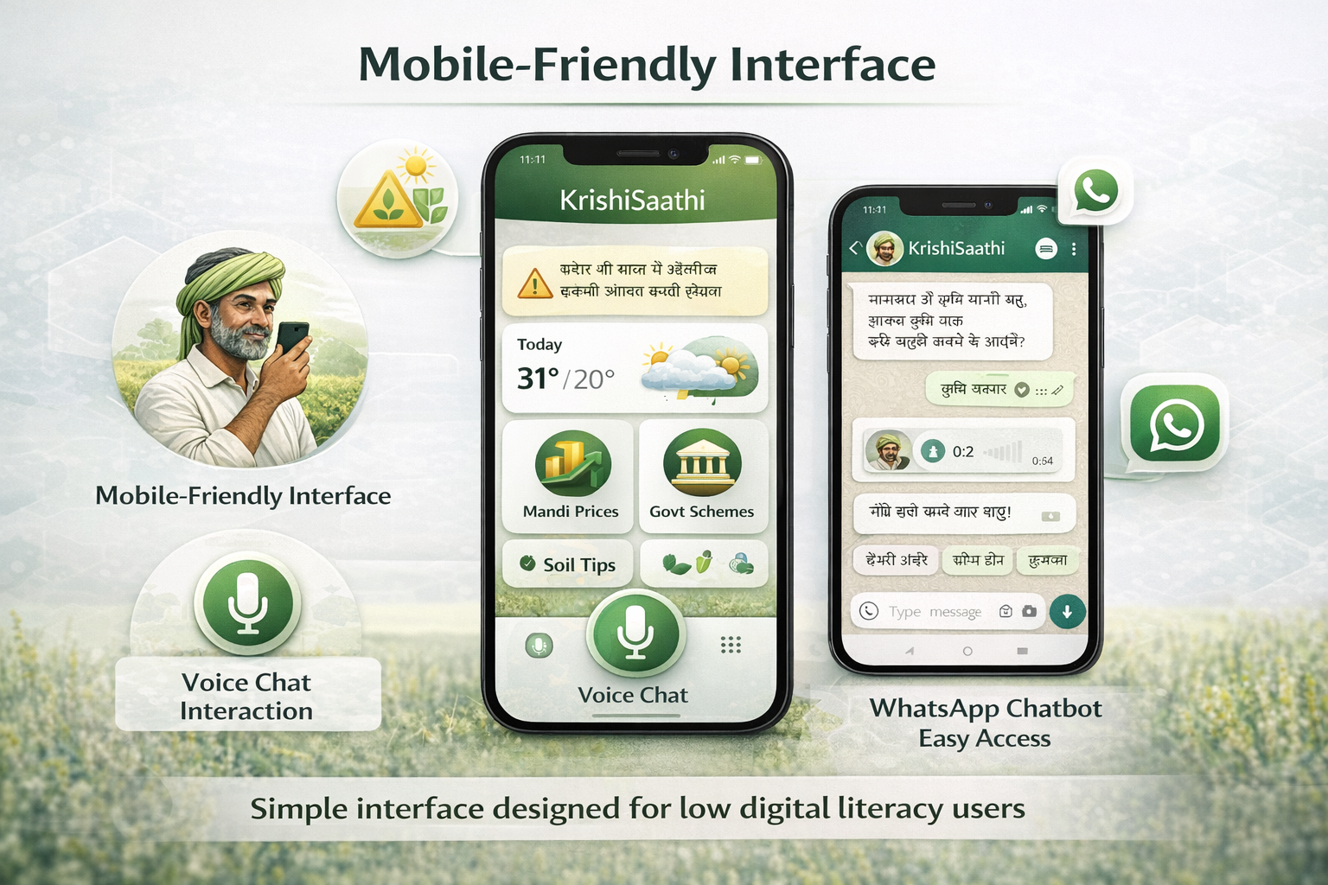
App Mockup – KrishiSaathi Interface

Slide 9
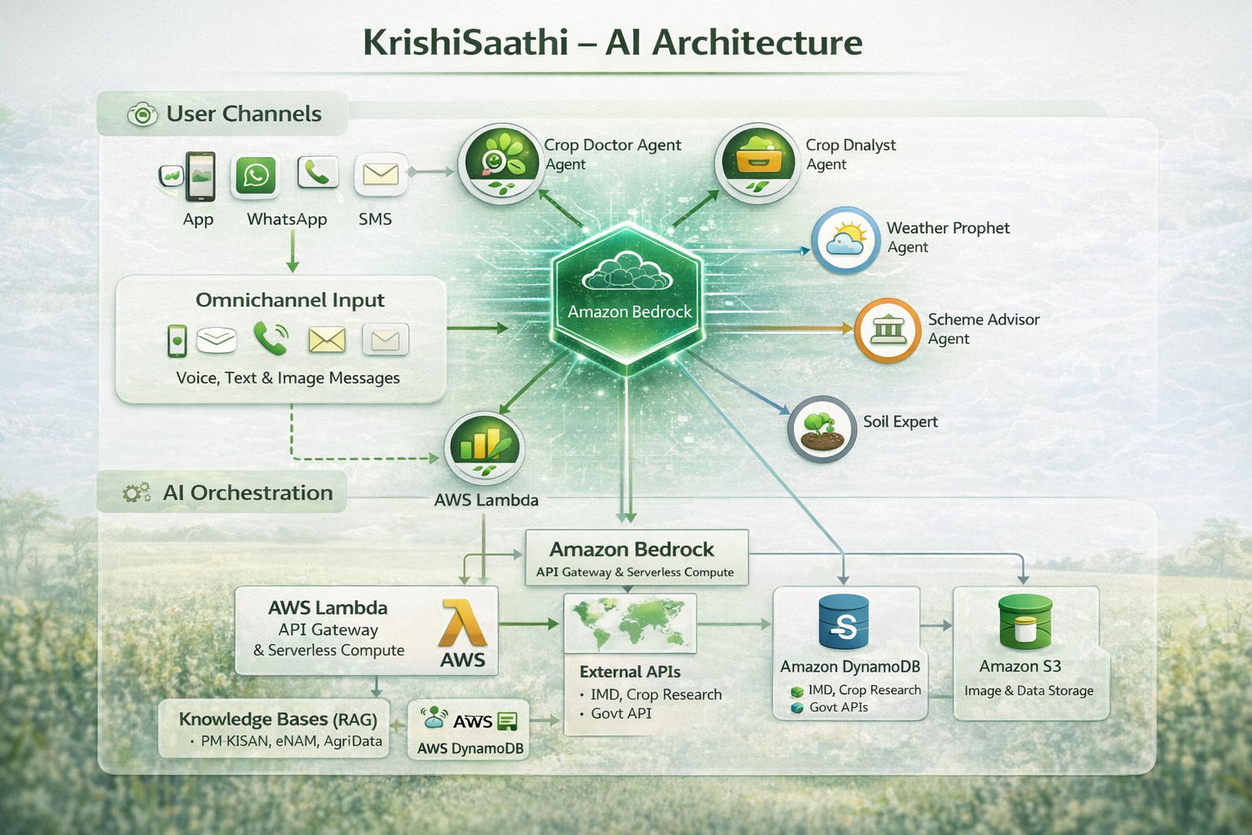
Architecture Diagram

Slide 10
Technologies to be used
AI/ML: Amazon Bedrock, claude 3.5 Sonnet, Rekognition,Translate, Guardrails, Transcribe
Database: Amazon OpenSearch Serverless (Vector Store) and DynamoDB (User Profiles), Amazon S3.
Messaging: SNS, Amazon Connect, WhatsApp Business API(via Twilio)
Backend: AWS Lambda , Amazon API Gateway and Amazon Cognito.
Frontend: React.js PWA with offline support, TailWind CSS
External APIs: eNAM(Mandi), IMD(weather), PM-KISAN(Schemes), Twilio

Slide 11
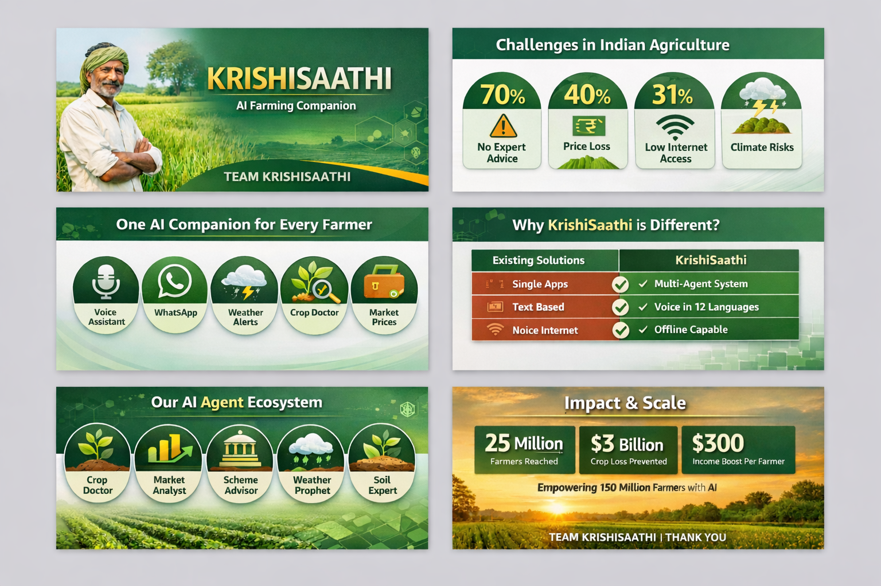
Estimated Cost & Impact
Implementation: < $100 for Hackathon POC; ~$790/month for 100,000 users.
Impact: Goal to reach 25 million farmers by Year 5, preventing billions in crop loss.
SDG Alignment: Supports SDG 1 (No Poverty), SDG 2 (Zero Hunger), and SDG 13 (Climate Action).

Slide 12
Conclusion
Why KrishiSaathi Wins: It directly addresses the "AI for Rural Innovation" track by bridging the digital divide with voice-first technology.
AWS Native Strength: The entire system is built to scale on a serverless architecture using Amazon Bedrock and Lambda.
Measurable Results: Our goal is to increase farmer income by 30-40% through market transparency and disease prevention.
Scalability: Regional scaling ensures that the intelligence is hyper-local, whether a farmer is in Punjab or Tamil Nadu.

Slide 13
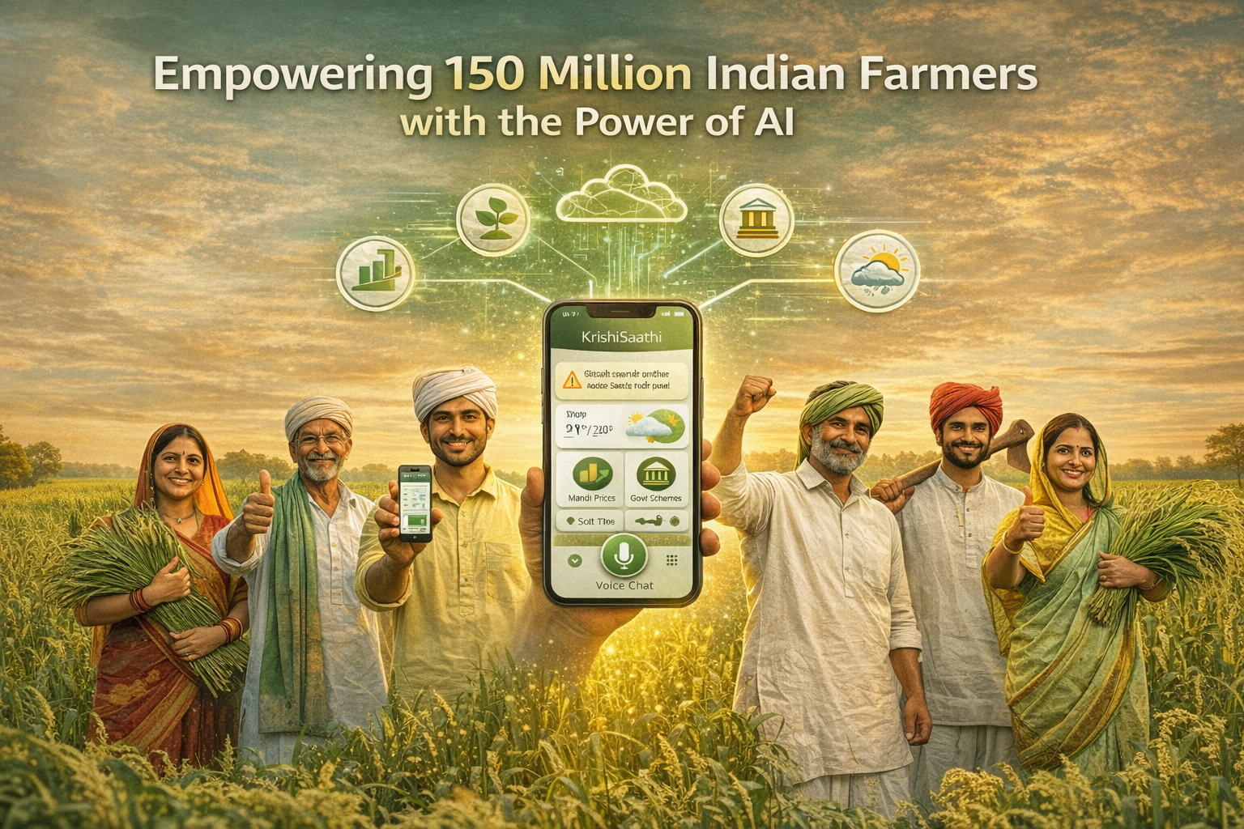

Slide 14
